Slide 1

CS 533 INTRO TO DATA SCIENCE
Michael Ekstrand

Slide 2
VECTORS AND SIMILARITY

Slide 3

Learning Outcomes
Understand the value of vector representations of instances.
Compute similarities between vectors
Photo by Yogendra Singh on Unsplash

Slide 4
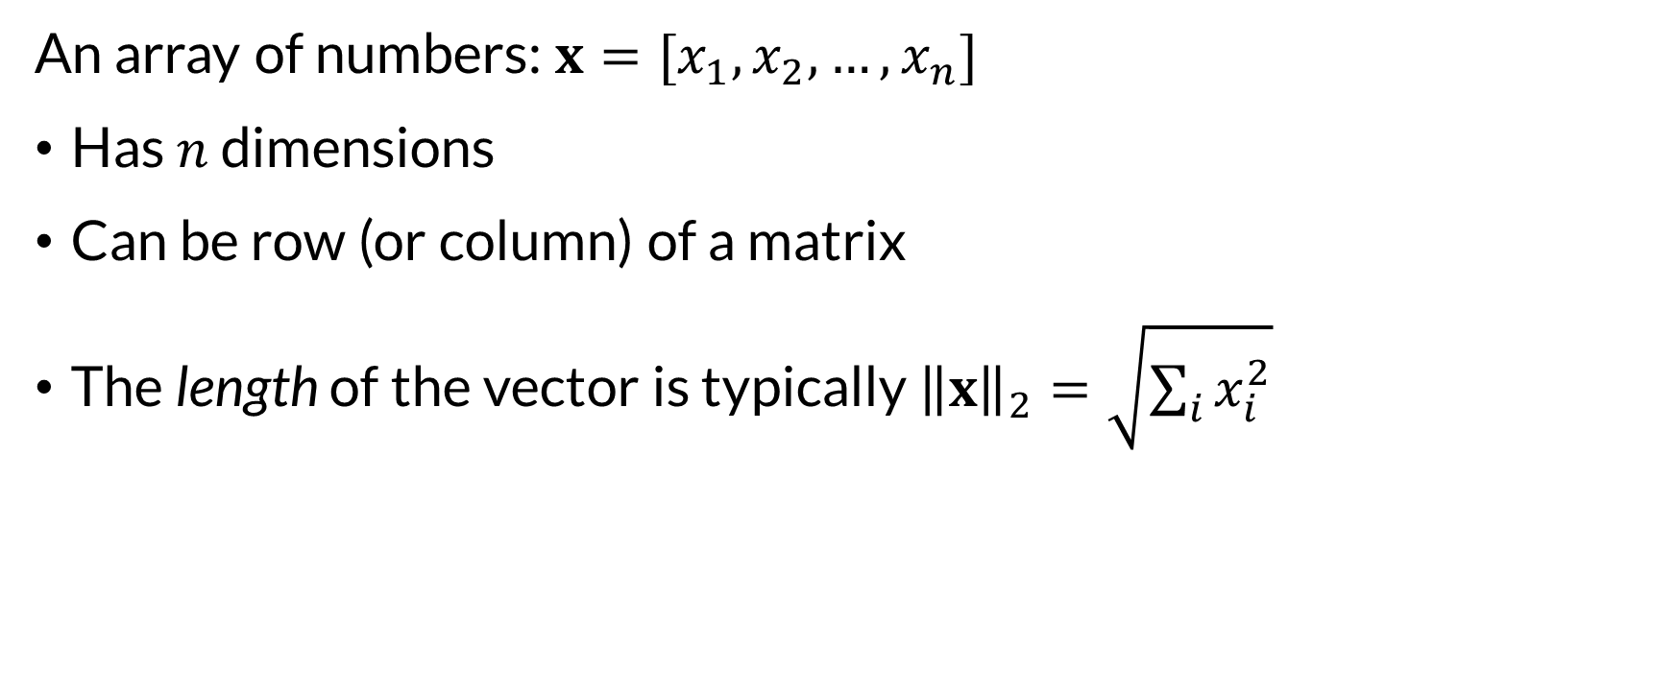
What Is a Vector?
An array of numbers: $x=[x_{1},x_{2},…,x_{n}]$
Has $n$ dimensions
Can be row (or column) of a matrix
The length of the vector is typically ${\left\|x\right\|}_{2}=\sqrt{\sum_{i}{x_{i}^{2}}}$

Slide 5
Homogenous and Heterogenous Vectors
An instance’s features form a vector (array of values)
Different features have different scales (unless standardized)
Not necessarily meaningful to relate to each other
Homogenous vector representations are particularly useful
All entries are the same ‘kind’ of thing
Positions instances in a vector space

Slide 6

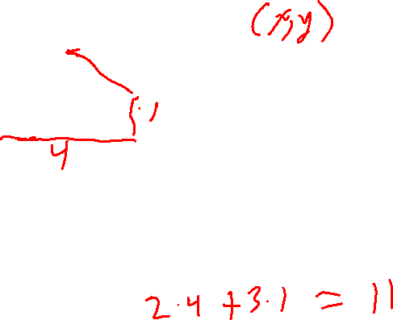
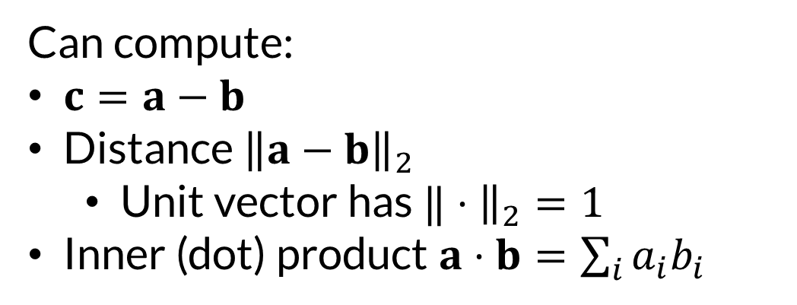

Vectors
Can represent:
A point in space
A line from origin to point
$$a=(2,3)$$
$$b=(4,1)$$
Can compute:
$c=a−b$
Distance ${\left\|a−b\right\|}_{2}$
Unit vector has $‖⋅{\left.​\right\|}_{2}=1$
Inner (dot) product $a⋅b=\sum_{i}{a_{i}b_{i}}$

Slide 7
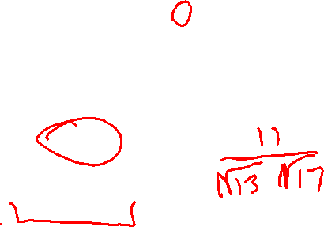
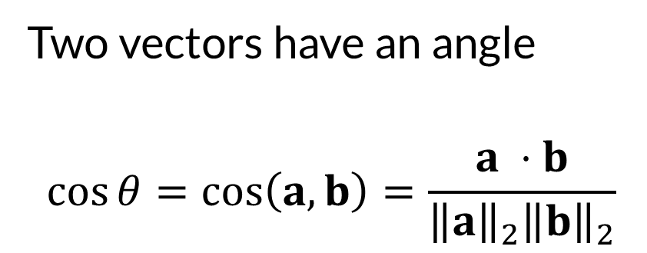

Angles
$$a=(2,3)$$
$$b=(4,1)$$
$$θ$$
Two vectors have an angle
$$\cos{θ}=\cos\left(a,b\right)=\frac{a ⋅b}{{\left\|a\right\|}_{2}{\left\|b\right\|}_{2}}$$

Slide 8
Vector Similarity
Cosine similarity is a common measure of object similarity
How related are two vectors?
If vectors are mean-centered, equivalent to Pearson correlation
Very common to do with TF-IDF vectors to compare documents

Slide 9
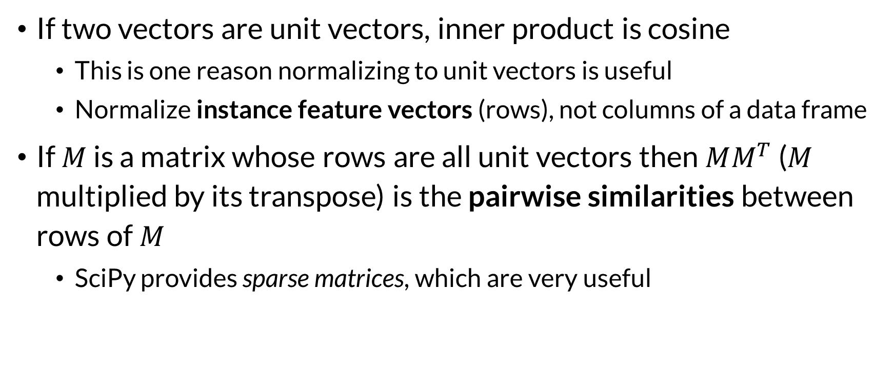
Tricks
If two vectors are unit vectors, inner product is cosine
This is one reason normalizing to unit vectors is useful
Normalize instance feature vectors (rows), not columns of a data frame
If $M$ is a matrix whose rows are all unit vectors then $MM^{T}$ ($M$ multiplied by its transpose) is the pairwise similarities between rows of $M$
SciPy provides sparse matrices, which are very useful

Slide 10

Wrapping Up
Vector representations such as TF-IDF can be used for further computations.
Similarity between vectors is often measured with their cosine, e.g. to compute similarity between documents.
Photo by Raquel Martínez on Unsplash

